Slide 1
Learn Python – 3
STEM Outreach

Slide 2
Agenda
Homework – Do together
More on Lists
Slicing
Append
Index/Reverse Indexing
https://www.techbeamers.com/python-list/
Walk through a Madlib
Variables
Names
Type
Data Types – Python does not have Data Types but just want to talk about them
Conditionals – Trinket
Homework
Questions/Feedback

Slide 3
Homework
Add numbers less than 10 using a list
What if I wanted number less than 5?
What if I wanted sum of numbers less than or equal to 9?

Slide 4
Lists
Slicing
theList = [1, 2, 3, 4, 5, 6, 7, 8]
theList[2:5] #[3, 4, 5]
theList[:2] #[1,2]
Appending a list
L1 = ['x', 'y’]
L1.append('a', 'b’) # returns an error why?
Index
vowels = ['a','e','i','o','u']
print(vowels[0]) # a
Reverse Indexing
vowels = ['a','e','i','o','u']
print(vowels[-1]) # u

Slide 5
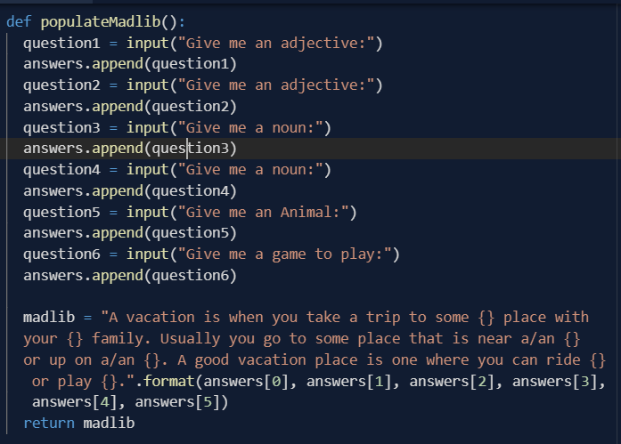
MadLib

Slide 6
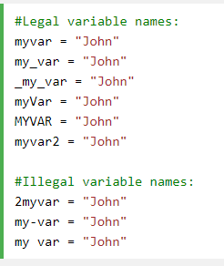
Variables
A variable name must start with a letter or the underscore character
A variable name cannot start with a number
A variable name can only contain alpha-numeric characters and underscores (A-z, 0-9, and _ )
Variable names are case-sensitive (age, Age and AGE are three different variables)
What does this print?
x = 5 y = "John" print(x + y)

Slide 7
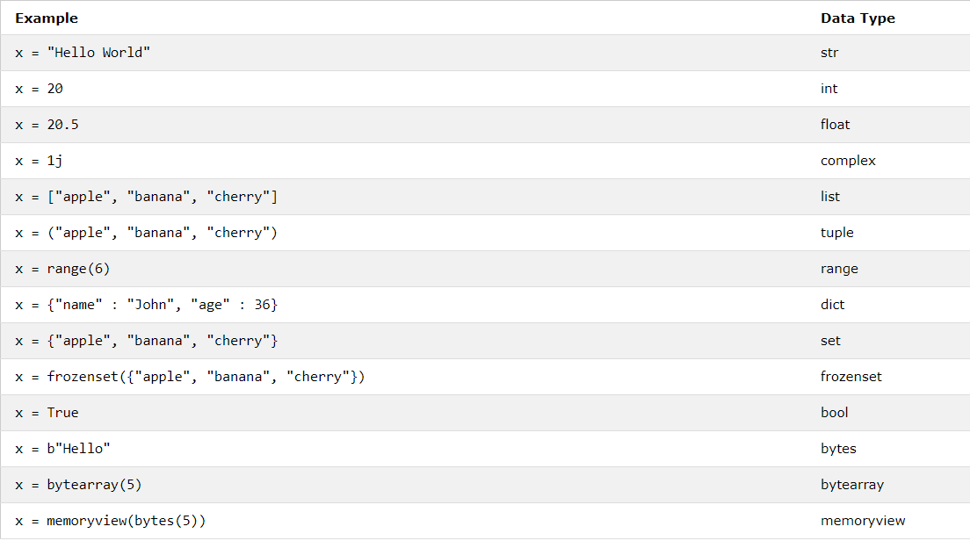
Data Types

Slide 8
Homework
Create your first game
Rock-Paper-Scissors – you will need to use randint(https://www.w3schools.com/python/ref_random_randint.asp)

